Slide 1
Unit 3: Disaster Medical Operations - Part 1
CERT Basic Training

Slide 2
Review
What disaster preparations did you do this week?
  Family plan / home
  Car
  Work
What is ICS?
Who becomes the CERT Team Leader (TL)? What does this person do?
What is the key question the CERT TL must always ask?
What are the key documents?

Slide 3
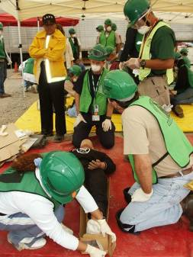
Unit 3 Objectives
Identify life-threatening conditions including
  Blocked airway
  Severe bleeding
  Shock (low body temperature)
Apply correct life saving techniques
Triage
Provide basic first-aid care for non-life threatening injuries
PM 3-1
CERT Basic Training Unit 3: Disaster Medical Operations – Part 1
3-1

Slide 4
Assumptions
Need for CERT members to learn disaster medical operations is based on two assumptions:
  Number of survivors could exceed local capacity for treatment
  Survivors will assist others
    They will do whatever they know how to do
    They need to know lifesaving first aid or post-disaster survival techniques
CERT Basic Training Unit 3: Disaster Medical Operations – Part 1
3-2

Slide 5
Safety Considerations
Ensure patient and rescuer are in a safe place
Some questions CERT volunteers to consider
  Do I feel safe at this spot?
  Should I leave and move to a safer location, or am I able to stay and start providing care immediately?
  If I leave, can I take anyone with me?
PM 3-2
CERT Basic Training Unit 3: Disaster Medical Operations – Part 1
3-3

Slide 6
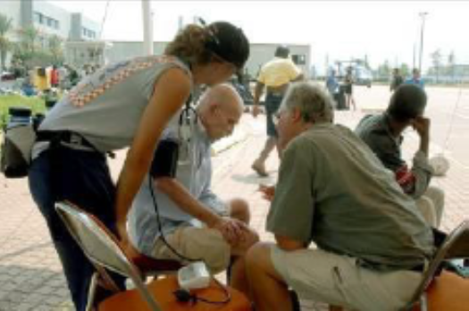
Approaching the Patient
Be sure patient can see you
Identify yourself
  Your name and name of your organization
Request permission to treat, if possible
Respect cultural differences
Protect patient privacy
Wear all medical PPE and
follow CDC guidelines
when approaching a patient
PM 3-2
CERT Basic Training Unit 3: Disaster Medical Operations – Part 1
3-4

Slide 7
Remember This!
Check Airway
-- Respiration >30 bpm = BAD
2. Check Circulation
  Perfusion: Blanch Test >2 seconds = BAD
3. Check Mental Status:
  Unconscious = BAD
  Can’t follow simple commands = BAD
“30 – 2 - CAN DO”

Slide 8
Remember This!
30 – 2 – Can Do!

Slide 9
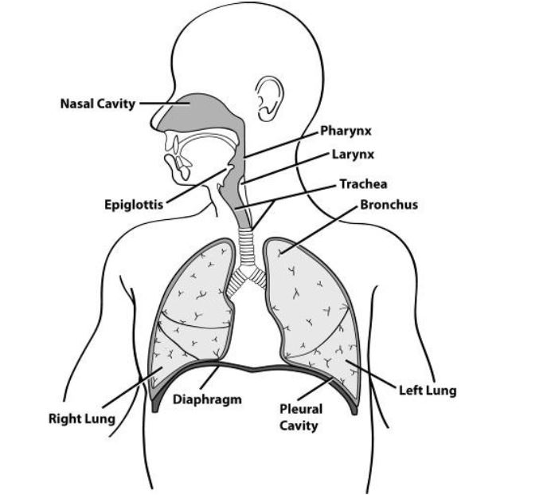
Opening the Airway
PM 3-6
CERT Basic Training Unit 3: Disaster Medical Operations – Part 1
3-14

Slide 10
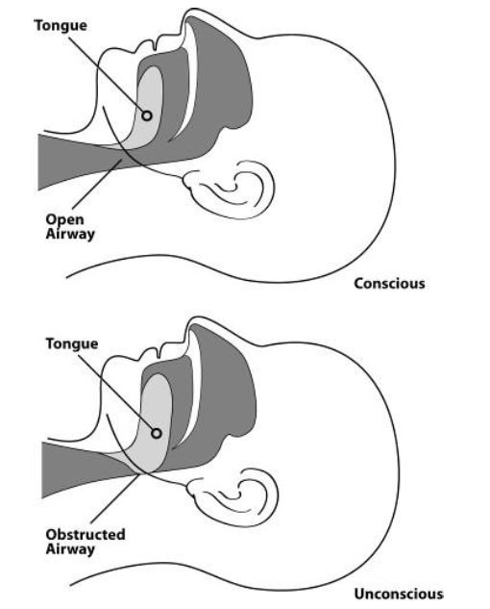
Open vs. Obstructed Airway
PM 3-6
CERT Basic Training Unit 3: Disaster Medical Operations – Part 1
3-15

Slide 11
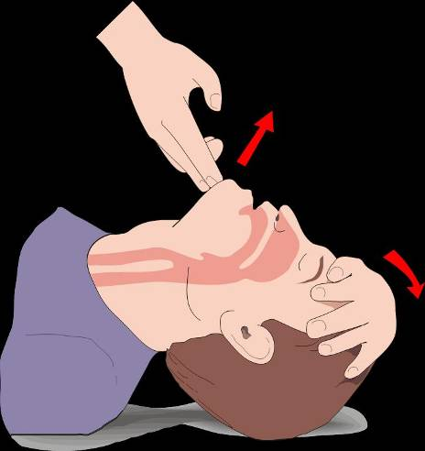
Head Tilt / Chin Lift

Slide 12
Jaw-thrust Maneuver
Kneel above the patient’s head
Put one hand on each side of the patient’s head with the thumbs near the corners of the mouth pointed toward the chin, using the elbows for support
Slide the fingers into position under the angles of the patient’s jawbone without moving the head or neck
Thrust the jaw upward without moving the head or neck to lift the jaw and open the airway
PM 3-7
CERT Basic Training Unit 3: Disaster Medical Operations – Part 1
3-19

Slide 13
Positioning a Conscious Patient
When sitting on a raised platform (e.g., chair, bench): Legs shoulder width apart, elbows or hands on knees, and leaning slightly forward
When standing: Legs shoulder width apart, hands on knees arms straight, and leaning forward with flat back
PM 3-6
CERT Basic Training Unit 3: Disaster Medical Operations – Part 1
3-16

Slide 14
Positioning an Unconscious Patient
PM 3-7
CERT Basic Training Unit 3: Disaster Medical Operations – Part 1
3-17

Slide 15
Recovery Position
Body: Laid on its side
Bottom Arm: Reached outward
Top Arm: Rest hand on bicep of bottom arm
Head: Rest on hand
Legs: Bent slightly
Chin: Raised forward
Mouth: Pointed downward
PM 3-7
CERT Basic Training Unit 3: Disaster Medical Operations – Part 1
3-18
Notes:
DEMO!!! Of recovery position (practice again during Head 2 Toe)
Maybe just use the image instead of the words

Slide 16
Exercise 3.2
Break into pairs and have one person play the rescuer and one person play the patient
Assume that the unconscious injured individual is breathing
Place them into the recovery position using the technique you just learned
PM 3-8
CERT Basic Training Unit 3: Disaster Medical Operations – Part 1
3-20
Notes:
To be used with Head to Toe in Unit 4

Slide 17
Remember This!
30 – 2 – Can Do!

Slide 18
Life-Threatening Bleeding
Indicators of life-threatening bleeding:
  Spurting/steady bleeding
  Blood is pooling
  Blood is soaking through over lying clothes
  Blood is soaking through bandages
  Amputation
PM 3-3
CERT Basic Training Unit 3: Disaster Medical Operations – Part 1
3-5
Notes:
Add image

Slide 19
Stages of Severe Bleeding
Stage | Blood Loss | Heart Rate | Blood Pressure | Breath Rate | Patient
I | Less than 15% | Normal <100 bpm | Normal | 14-20 | Appears normal
II | 15%-30% | Fast >100 bpm | Slightly Low | 20-30 | May feel anxious
III | 30%-40% | Very Fast >120 bpm | Low | 30-40 | Feels confused
IV | Greater than 40% | Critical >140 bpm | Critical | >35 | Feels lethargic
PM 3-3
3-6
Notes:
Joyce –Make the chart more readable

Slide 20
Types of Bleeding
Arterial bleeding: Arteries transport blood under high pressure
  Spurting
Venous bleeding: Veins transport blood under low pressure
  Flowing
Capillary bleeding: Capillaries also carry blood under low pressure
  Oozing
PM 3-3
CERT Basic Training Unit 3: Disaster Medical Operations – Part 1
3-7
Notes:
With this image can we get rid of previous slide?

Slide 21
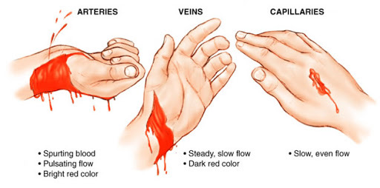
Types of Bleeding (image)
PM 3-3
CERT Basic Training Unit 3: Disaster Medical Operations – Part 1
3-8
Notes:
Look for new image of types of bleeding

Slide 22
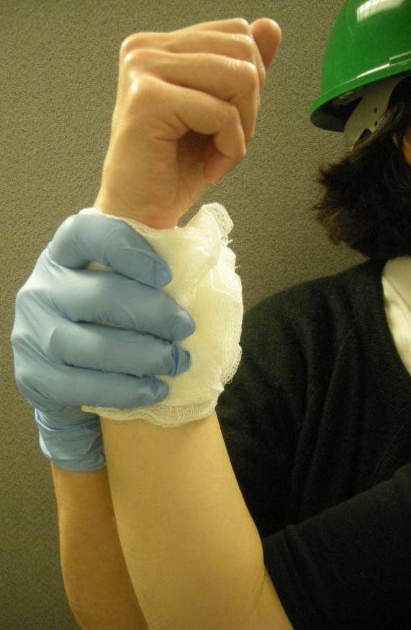
Controlling Bleeding: Direct Pressure
Step 1: Find the source(s)
Step 2: Cover the source
Step 3: Apply pressure
Step 4: Maintain pressure
until bleeding has stopped
If deep wound – pack the wound
(Advanced training – Stop the Bleed)
PM 3-3
CERT Basic Training Unit 3: Disaster Medical Operations – Part 1
3-9
Notes:
Add images - visual

Slide 23
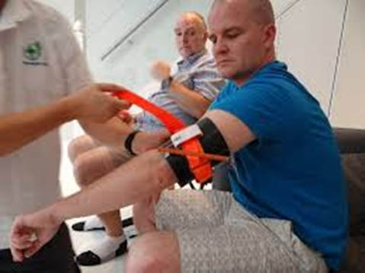
Controlling Bleeding: Tourniquets & Israeli Bandage
For unstoppable bleeding
  Amputated or crushing injury to limb
Use tourniquet or long, flat, soft material like a belt or tie
  Cuts off blood supply to body part below injury, “life or limb” situation
Indicate Time and Date applied
Only to be removed by health
professional
PM 3-4
Notes:
Demo and practice: Place on injured limb above injury, Pull strap through buckle
Twist rod until bleeding stops/slows , Secure the rod , If bleeding continues, place second tourniquet
Leave in place until EMS takes over

Slide 24
Exercise 3.1
After breaking into pairs, identify one person to take the role of the patient and one to take the role of the rescuer
Respond as if the patient has an injury on the right forearm, just below the elbow
Apply
  Pressure bandage
  Israeli bandage
PM 3-6
CERT Basic Training Unit 3: Disaster Medical Operations – Part 1
3-13

Slide 25
Remember This!
30 – 2 – Can Do!

Slide 26
Shock
Shock is often difficult to diagnose
Main signs of shock:
  Rapid and shallow breathing
  Capillary refill of greater than two seconds
  Failure to follow simple commands, such as “squeeze my hand
Symptoms of shock are easily missed. Pay careful attention to your patient
PM 3-5
CERT Basic Training Unit 3: Disaster Medical Operations – Part 1
3-11
Notes:
Teach cap refill. New image from a CERT class in El Paso

Slide 27
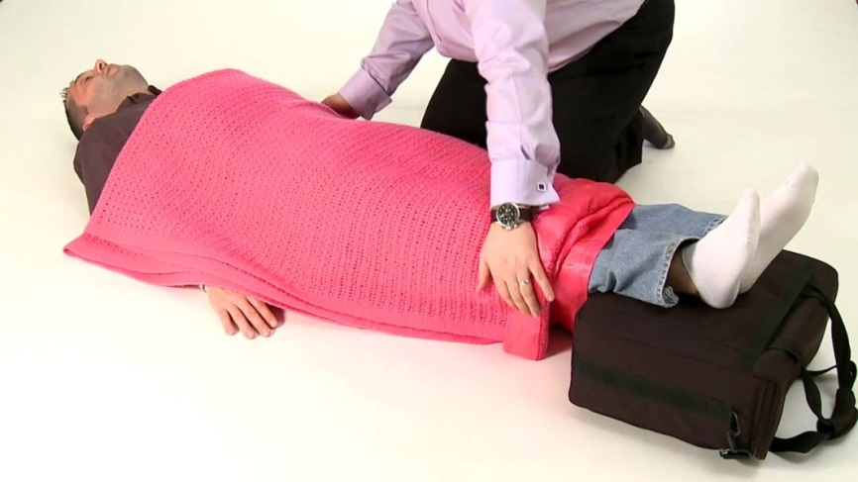
Maintaining Body Temperature
Keep the patient warm
  Remove wet clothing
  Place something between patient and ground (e.g., cardboard, jacket, blanket)
  Wrap patient with dry layers (e.g., coat, blanket, Mylar emergency blanket)
  Shield patient from wind
PM 3-5
CERT Basic Training Unit 3: Disaster Medical Operations – Part 1
3-12

Slide 28

Break
Return at
_______
After Break:
Practice Triage

Slide 29
STaRT
STart = Simple Triage
  Victims sorted based on priority of treatment
stART = And Rapid Treatment
  Rapid treatment of injuries assessed and prioritized in first phase

Slide 30
What is Triage?
Process for managing mass casualty event
  Evaluate the survivors
  Patients are sorted by severity of injury
  Patients are prioritized for immediate or delayed treatment
Notes:
Next slide is bus triage video. 18 minutes

Slide 31


Slide 32
Triage
Immediate (I): Victim has life-threatening injuries (airway, bleeding, or shock)
Delayed (D): Injuries do not jeopardize victim’s life; treatment can be delayed
Minor (M): Walking wounded and generally ambulatory
Dead (DEAD): No respiration after two attempts to open airway

Slide 33
Rescuer Safety During Triage
If hazmat or terrorist event is suspected, CERT members DO NOT respond
  Evacuate as safely as possible
ALWAYS wear PPE:
  Helmet
  Goggles
  N95 mask
  Work gloves
  Sturdy shoes or boots
  Non-latex exam gloves

Slide 34
Triage Process
Step 1: Stop, Look, Listen, and Think
Step 2: Conduct voice triage
Step 3: Start where you stand; follow systematic route
Step 4: Evaluate each victim and tag
Step 5: Treat “I” life threats immediately
Step 6: Document triage results

Slide 35
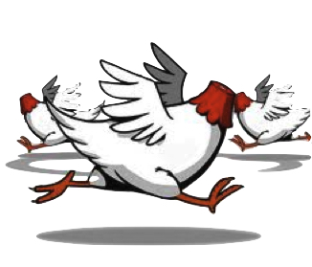
Triage Pitfalls
No team plan, organization, or goal
Indecisive leadership
Too much focus on one injury
Treatment (rather than triage)
Notes:
Find better picture – long skinny of crazy panic Humorous

Slide 36
Activity Time
Teddy Bear Triage

Slide 37
Triage Evaluation = RPM
Check Airway:
-- Respiration >30 bpm = IMMEDIATE
Check Circulation
  Perfusion: Blanch Test >2 seconds = IMMEDIATE
Check Mental Status
-- Unconscious = IMMEDIATE
-- Can’t follow simple commands = IMMEDIATE
“30 – 2 - CAN DO”

Slide 38
Providing Comfort
What can you do?
  Keep them warm
  Offer a hand to hold
  Maintain eye contact
  Be patient and understanding
  If you have to move on to provide aid to another person, let them know
PM 3-8
CERT Basic Training Unit 3: Disaster Medical Operations – Part 1
3-21
Notes:
Add an image

Slide 39

Break
RETURN AT
_____
for
Basic First Aid and Splinting

Slide 40
Treating Burns
Goals
  Prevent hypothermia
  Manage pain
  Reduce risk of infection
PM 3-9
CERT Basic Training Unit 3: Disaster Medical Operations – Part 1
3-22
Notes:
Note – Dos and Don’ts were removed. Put back in?

Slide 41
Burn Severity
Factors that affect burn severity:
  Temperature of burning agent
  Period of time survivor exposed
  Area of body affected
  Size of area burned
  Depth of burn
PM 3-9
CERT Basic Training Unit 3: Disaster Medical Operations – Part 1
3-23

Slide 42
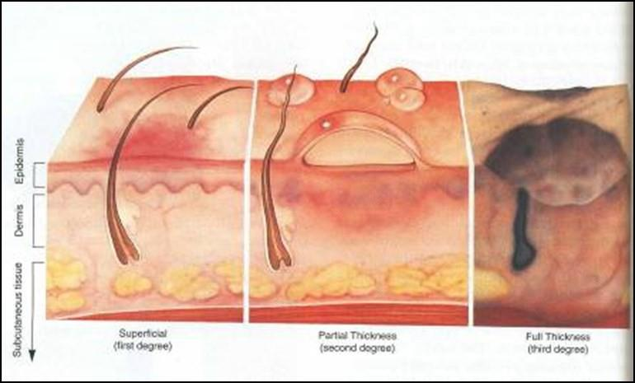
Burn Classifications
Superficial: epidermis
Partial Thickness: dermis and epidermis
Full Thickness: subcutaneous layer and all layers above
PM 3-9
CERT Basic Training Unit 3: Disaster Medical Operations – Part 1
3-24

Slide 43
Treatment for Chemical Burns
Remove cause of burn and affected clothing or jewelry
If irritant is dry, gently brush away as much as possible
  Always brush away from eyes, survivor, and yourself
Flush with lots of cool running water
Apply cool, wet compress to relieve pain
Cover wound loosely with dry, sterile or clean dressing
PM 3-10
CERT Basic Training Unit 3: Disaster Medical Operations – Part 1
3-25

Slide 44
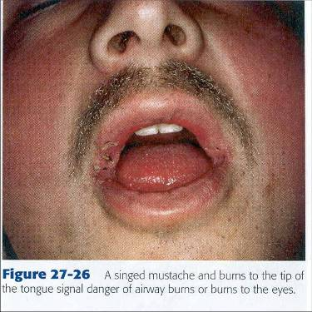
Inhalation Burns
Sudden loss of consciousness
Evidence of respiratory distress or upper airway obstruction
Soot around mouth or nose
Singed facial hair
Burns around face or neck
CERT Basic Training Unit 3: Disaster Medical Operations – Part 1
3-25
Notes:
I added this one back in because of fires in CA

Slide 45
Wound Care
Main treatment for wounds:
  Control bleeding
  Apply dressing and bandage
Apply dressing and bandage:
  Apply dressing directly to wound
  Bandage holds dressing in place
PM 3-11
CERT Basic Training Unit 3: Disaster Medical Operations – Part 1
3-26

Slide 46
Rules of Dressing
If active bleeding:
  Redress OVER existing dressing
If no active bleeding:
  Maintain the pressure and keep wound bandaged until further treatment by a medical professional
PM 3-11
CERT Basic Training Unit 3: Disaster Medical Operations – Part 1
3-27

Slide 47
Signs of Infection
Signs of possible infection:
  Swelling around wound site
  Discoloration
  Discharge from wound
  Red striations from wound site
Irrigate with sterile water
  Check periodically for infection
PM 3-11
CERT Basic Training Unit 3: Disaster Medical Operations – Part 1
3-28

Slide 48
Amputations
Control bleeding; treat shock
If amputated body part is found:
  Save tissue parts, wrapped in clean material and placed in plastic bag
  Keep tissue parts cool, but NOT directly on ice
  Keep severed part with survivor
PM 3-11
CERT Basic Training Unit 3: Disaster Medical Operations – Part 1
3-29

Slide 49
Impaled Objects
When foreign object is impaled in patient’s body:
  Immobilize affected body part
  Do not attempt to move or remove
  Try to control bleeding at entrance wound
  Clean and dress wound, making sure to stabilize impaled object
PM 3-12
CERT Basic Training Unit 3: Disaster Medical Operations – Part 1
3-30

Slide 50
Fractures, Dislocations, Sprains, Strains
Immobilize injury and joints immediately above and below injury site
If uncertain of injury type, treat as fracture
PM 3-12
CERT Basic Training Unit 3: Disaster Medical Operations – Part 1
3-31

Slide 51
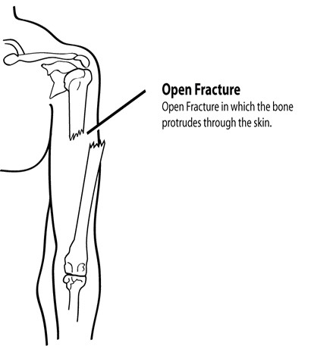
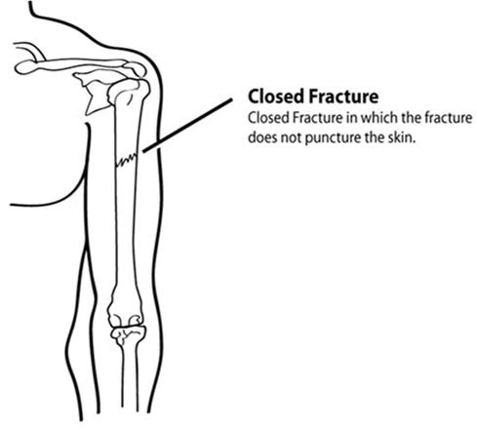
Types of Fractures (1 of 2)
PM 3-12
CERT Basic Training Unit 3: Disaster Medical Operations – Part 1
3-32

Slide 52
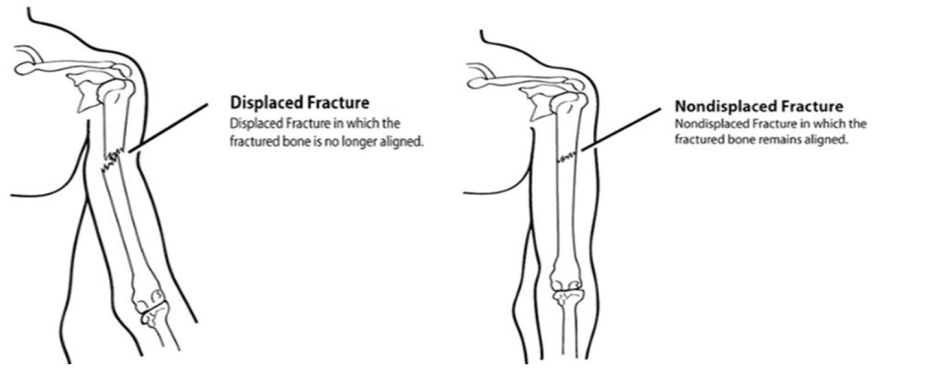
Types of Closed Fractures (2 of 2)
PM 3-13
CERT Basic Training Unit 3: Disaster Medical Operations – Part 1
3-33

Slide 53
Treating Open Fractures
Do not draw exposed bone ends back into tissue
Do not irrigate wound
Cover wound with sterile dressing
Splint fracture without disturbing wound
Place moist dressing over bone end
PM 3-13
CERT Basic Training Unit 3: Disaster Medical Operations – Part 1
3-34

Slide 54
Dislocations & Sprains
Dislocation is injury to ligaments around a joint
  So severe that it permits separation of bone from its normal position in a joint
Sprains
  Tenderness at site
  Swelling and bruising
  Restricted use or loss of use
PM 3-13
CERT Basic Training Unit 3: Disaster Medical Operations – Part 1
3-35

Slide 55
Treatment
For fractures, sprains & strains
  Treat all as if broken
  Immobilize as found; do NOT attempt bone alignment
  Check Pulse, Movement, and Sensation (PMS) before and after splinting/immobilization
PM 3-14
CERT Basic Training Unit 3: Disaster Medical Operations – Part 1
3-36

Slide 56
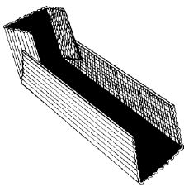
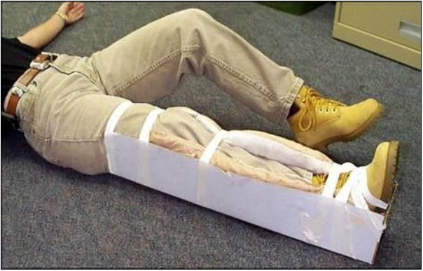
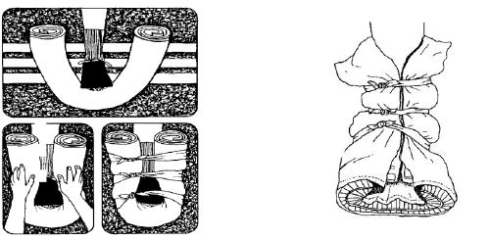
Splinting
PM 3-14
CERT Basic Training Unit 3: Disaster Medical Operations – Part 1
3-37

Slide 57
Demonstration & Practice
Practice makes perfect
PM 3-14
Notes:
Activity. In pairs class practices putting on a split and sling for lower arm factice, immobilizing both the wrist and elbow. If time can try ankle or lower leg

Slide 58
Unit Summary (Unit 3)
Life-saving measures CERT volunteers can take:
  Control bleeding using direct pressure and/or a tourniquet
  Maintain normal body temperature
  Open airway and position patient correctly
Other injuries that are common after disasters:
  Burns
  Wounds
  Amputations and impaled objects
  Fractures, dislocations, sprains, and strains
PM 3-19
CERT Basic Training Unit 3: Disaster Medical Operations – Part 1
3-49

Slide 59
Homework Assignment (Unit 3)
Read Unit 4 (Disaster Medicine Part 2 and Unit 5 (Disaster Psychology) to be covered in next session. Complete the Self-care toolkit pgs 5-4 to 5-6
Wear appropriate clothes for next session
  We will be demonstrating and practicing Head to Toe assessment
PM 3-19
CERT Basic Training Unit 3: Disaster Medical Operations – Part 1
3-50

